Slide 1
Using the EMB3RS Heat & Cold matching platform
gardumi@kth.se
skpk@kth.se

Slide 2
Introduction to workshop - Agenda
9:00 – 9:05 (CEST) | Welcome and Introduction to the test case for the workshop
9:05 – 9:30 | Description of the EMB3RS platform and its parts
9:30 – 10:15 | Hands-on experience with the interface, its working principles, its inputs
10:15 – 10:30 | Discussion

Slide 3
Introduction to workshop - Structure and organisation
During the first half hour, the developers will illustrate the Platform and its functionalities.
The remaining part of the Workshop will be dedicated to hands-on experiences.
A short and simple case study using the platform
    Follow a step-by-step exercise prepared by the EMB3RS Team.
    Developers to guide you and discuss the exercise with you.
Plenary recap to discuss platform, functionalities, potential uses
Feedback

Slide 4
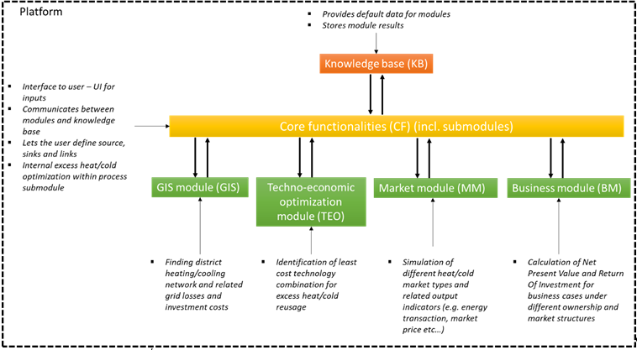
EMB3RS Platform

Slide 5
EMB3RS Platform
The EMB3RS platform performs the following list of actions:
Mapping of heat/cold sources and sinks
Automatic routing of pipelines
Calculation of heat losses in the network based on distance sources-sinks and their temperature
Calculation of costs for installation/construction of the network.
Cost of integrating surplus heat/cooling into a district heating and (or) cooling network.
Cost of integrating surplus heat/cooling into on-site processes.
Savings in energy sources and associated expenses from using surplus heat and cooling.
Calculation of economic impact (revenues & costs) for actors involved in the energy community
CO2 reduction using surplus heat/cold.
Cost of converting surplus heat into electricity.
The platform is available online
The source code of the platform and all the modules are available on GitHub here

Slide 6
Core Functionalities (CF) Description
The purpose of this module is to:
  Act as the main input interface for sinks and sources
  To convert sinks and sources to be compatible with the DHN
    For sinks, the conversion made would be either process heat or cold depending on the thermal energy needs
    Boosting technologies are considered when the available temperature is not sufficient to meet the DHN supply/return temperatures
  To perform internal heat recovery assessment for sources
        Assessing electricity production using an organic Rankine cycle
        Assessing internal heat exchanger networks by performing a pinch analysis
The source code of the CF module is available on GitHub here and the documentation available here

Slide 7
GIS Module Description
The purpose of the module is to analyze the spatial dimension of the EMB3Rs platform.
The GIS module conducts several calculations represented by the following main features
  District heating and cooling (DHC) network calculation based on different heat/cold sources and sinks to be included,
  Calculation of the thermal losses and investment costs of the resulting DHC net-work (grid).
The main outputs of the GIS module are:
  DHC network where all the possible sources and sinks are connected,
  Investment cost of the calculated DHC network,
  Thermal losses of the calculated DHC grid.
The source code of the GIS module is available on GitHub here and the module documentation is available in the ReadMe

Slide 8
Techno-economic optimisation (TEO) module description
The Techno-Economic Optimization (TEO) module identifies least-cost combinations of technologies
The user can evaluate the options of utilizing excess HC generated to meet the heating/cooling demand for one or more known/assumed sinks.
The objective of the optimization is to find the least-cost mix of technologies and match between sources and sinks
The module considers constraints dictated by regulation, availability of heat, load profiles,
It also considers techno-economic characteristics of technologies, investment plans, etc.
The techno-economic parameters for the technologies selected by TEO are openly available here. In a platform release to come soon, it will be possible to also set capacity and activity limits, etc.
The source code of the TEO module is available on GitHub here and the documentation available here

Slide 9
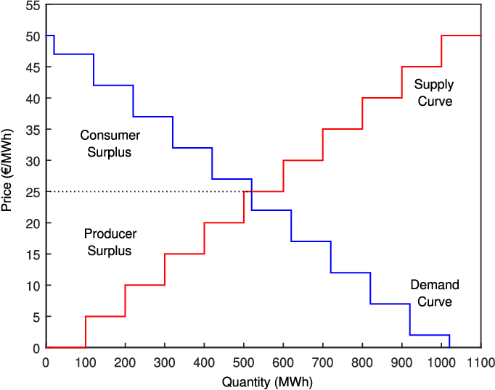
Market Module (MM) Description
Match supply and demand bids
Sources bid maximum generation and minimum price
Sinks bid maximum consumption and maximum willingness to pay
Short-term and Long-term
Market minimizes "Social Welfare"
Outcome:
  Schedule for each hour
  Market price for each hour
  Several derived quantities
The source code of the MM module is available on GitHub here and the module documentation is available in the ReadMe

Slide 10
Business Module (BM) Description
The business module evaluates the financial profitability of a project by calculating following metrics:
  Net Present Value (NPV) - Socio-economic & Private business scenarios
  Internal Rate of Return (IRR) - Socio-economic & Private business scenarios
  Payback period. - Socio-economic & Private business scenarios
  LCOH - Only Private business scenarios
The business module considers different ownership structures, which represent different business models.
The business module interacts directly with the techno-economic module (TEO), market module (MM), and the user.
The source code of the MM module is available on GitHub here and the module documentation is available in the ReadMe

Slide 11
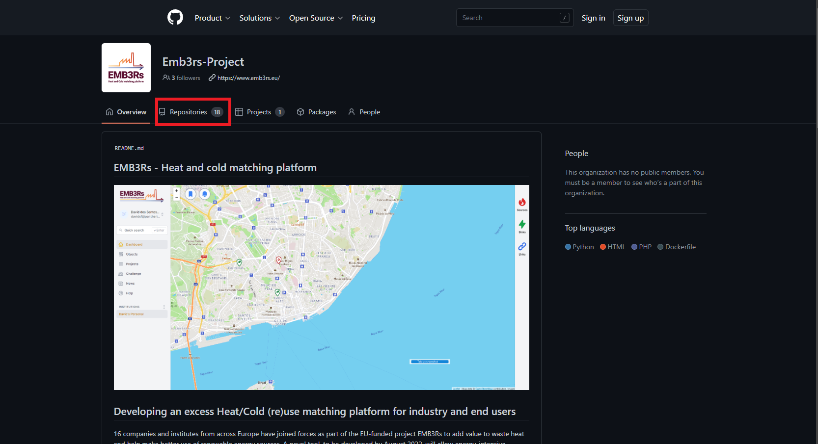
EMB3RS Platform - GitHub
The source code of the platform and all the modules are available on GitHub here

Slide 12
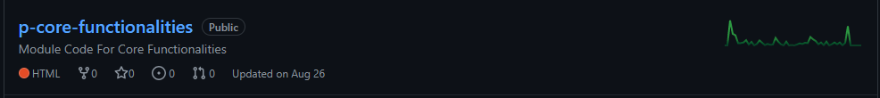
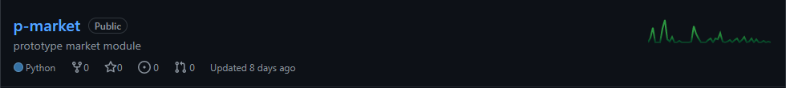
EMB3RS Platform - GitHub
The source code of the platform and all the modules are available on GitHub here

Slide 13
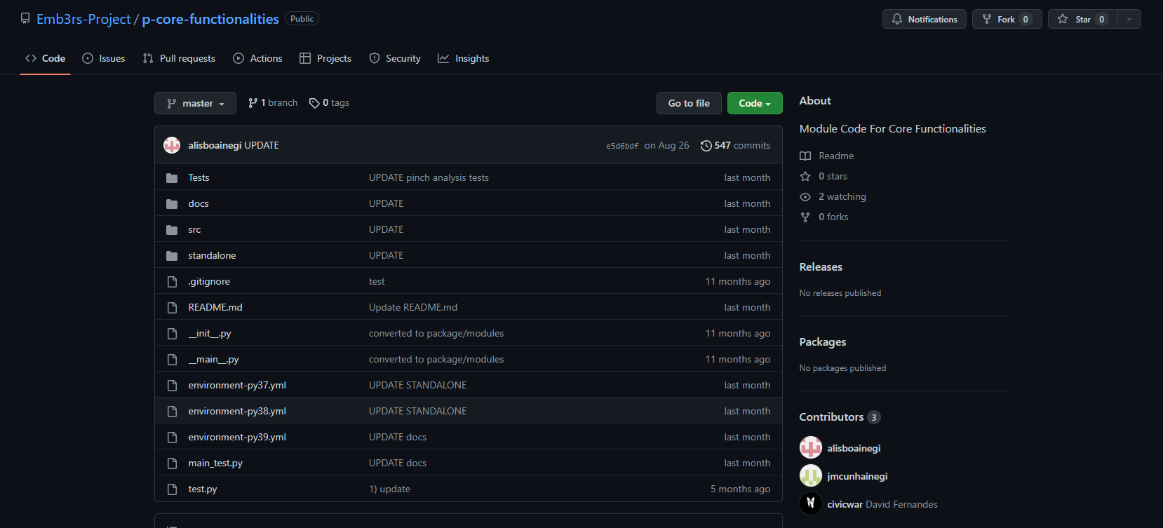
EMB3RS Platform - GitHub
The source code of the platform and all the modules are available on GitHub here

Slide 14
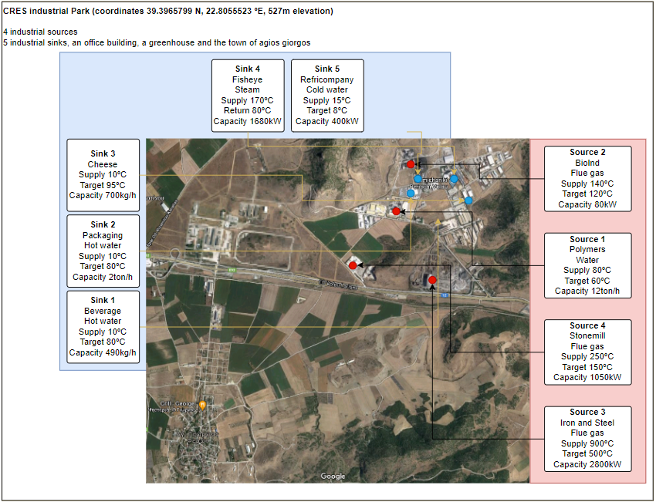
Case description
Volos Industrial Park (lat=39.396082; long=22.807625),
  near the town of Agios Georgios (lat=39.369967; long=22.776940) in Greece.
There are several industries with excess heat and industries
  There is also a large office and a greenhouse near the industrial park
  The town of Agios Georgios, although it is about 6 km away from the Volos Industrial Park, is also an interesting large consumer of heat due to the consumption of hot water by households and space heating.

Slide 15
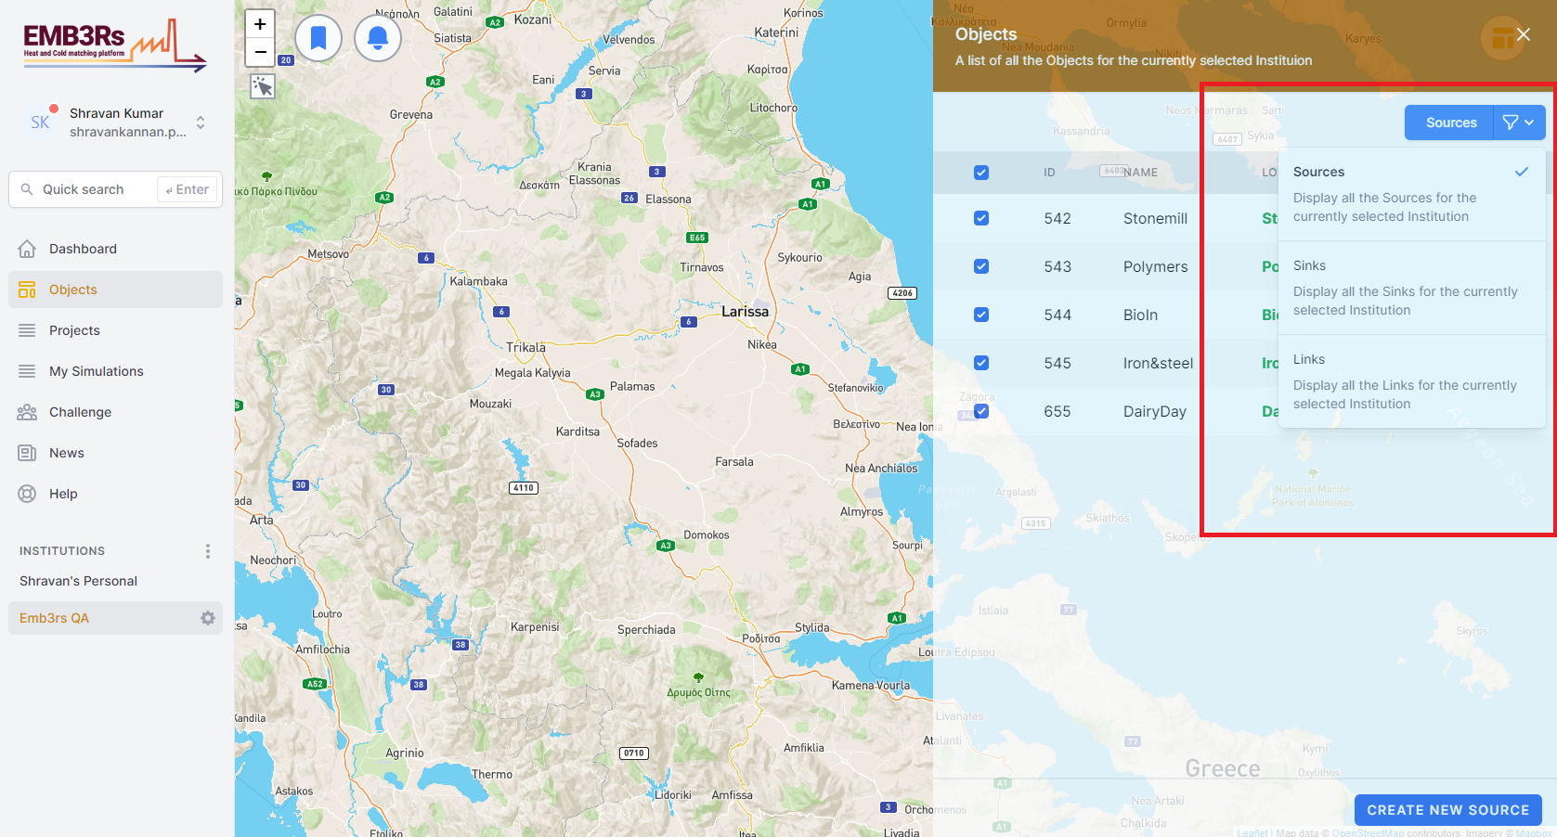
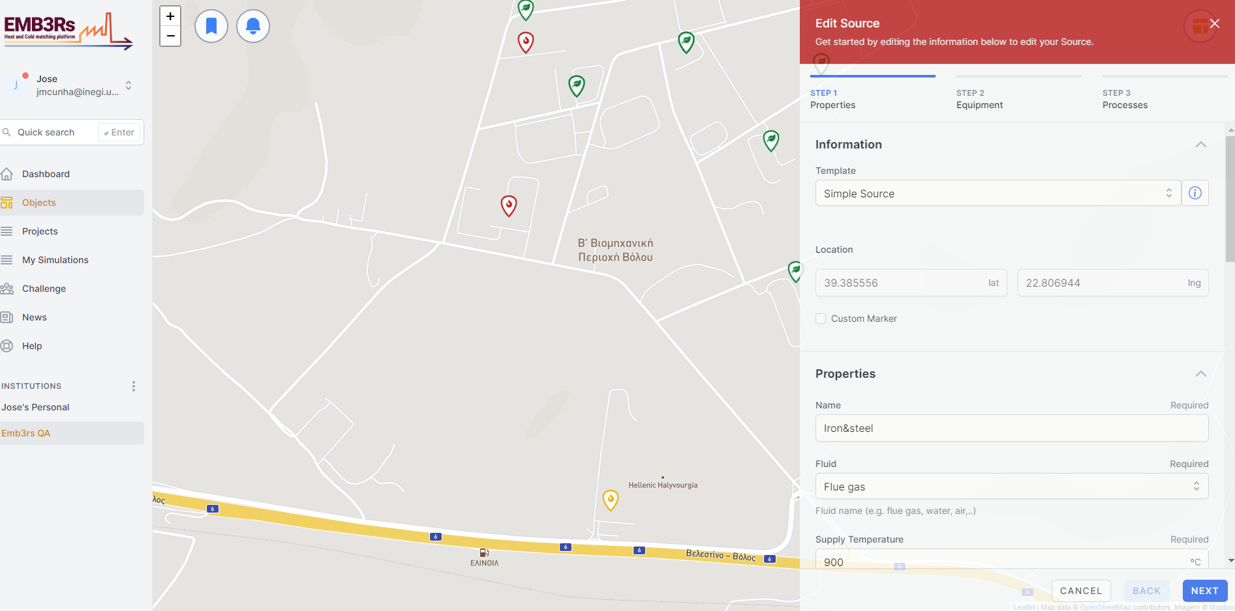
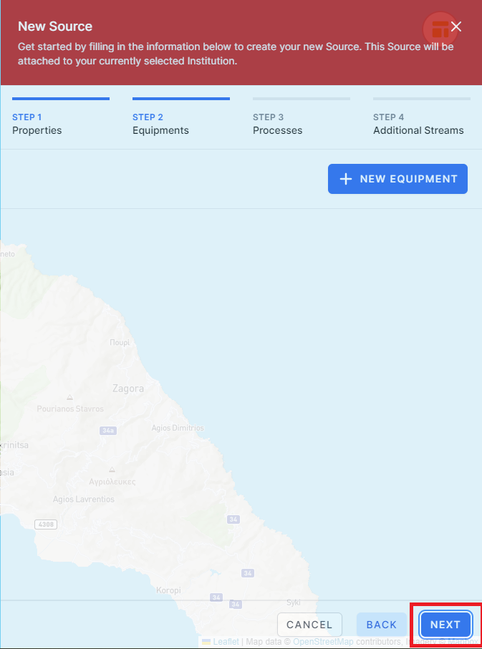
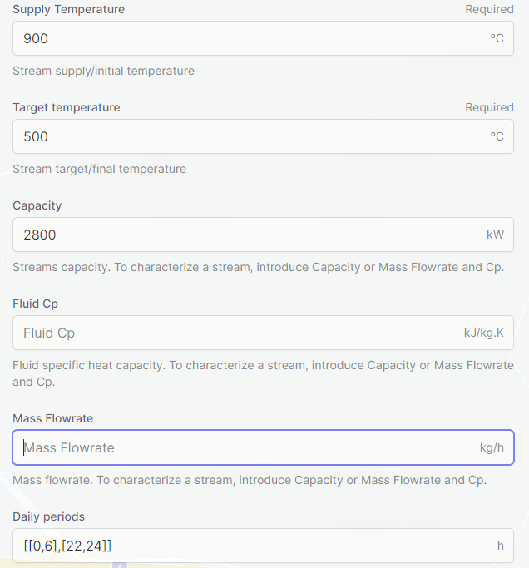
Case implementation – Source creation

Slide 16
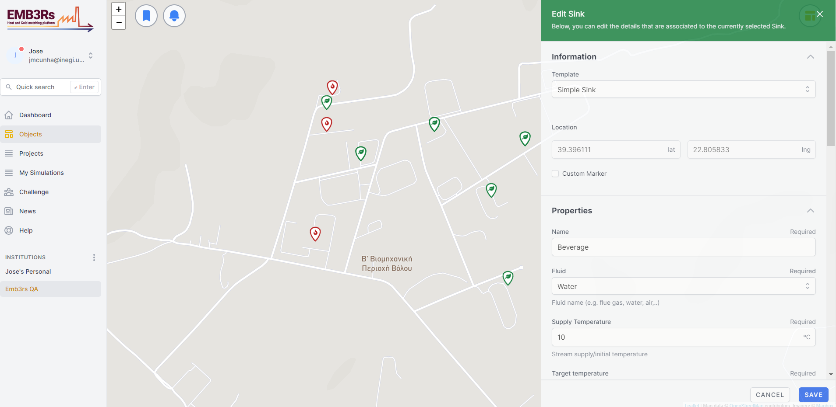
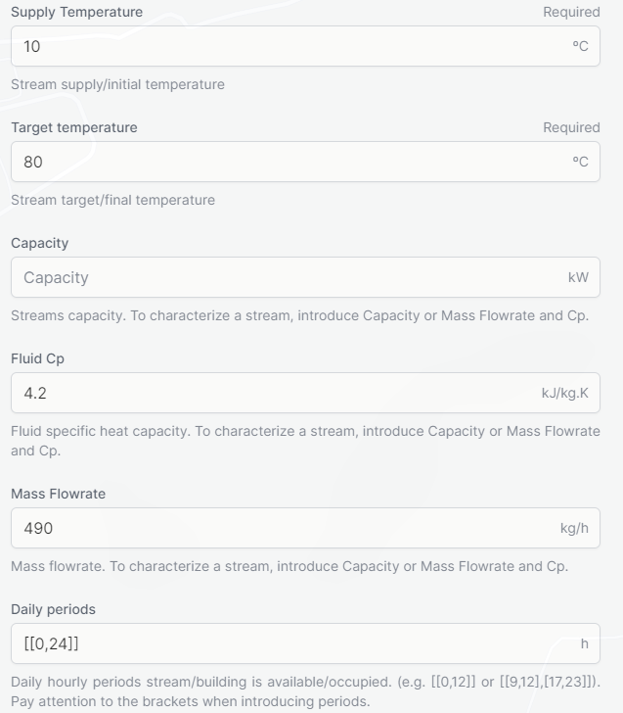
Case implementation –Sink creation (Industrial)

Slide 17
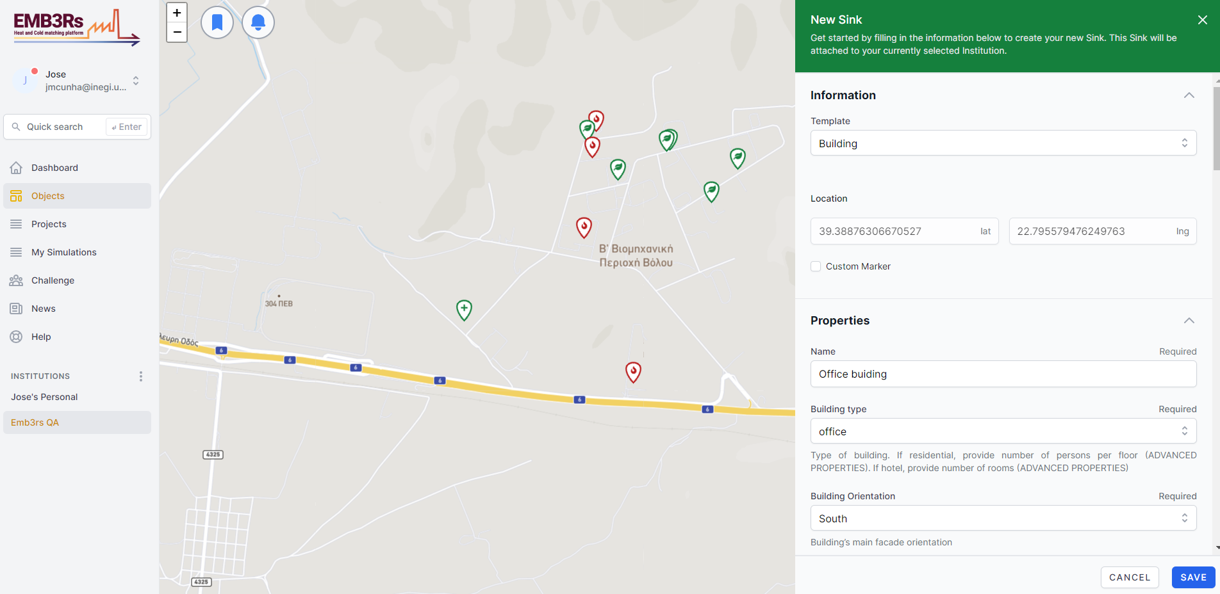
Case implementation –Sink creation (Office Building)

Slide 18
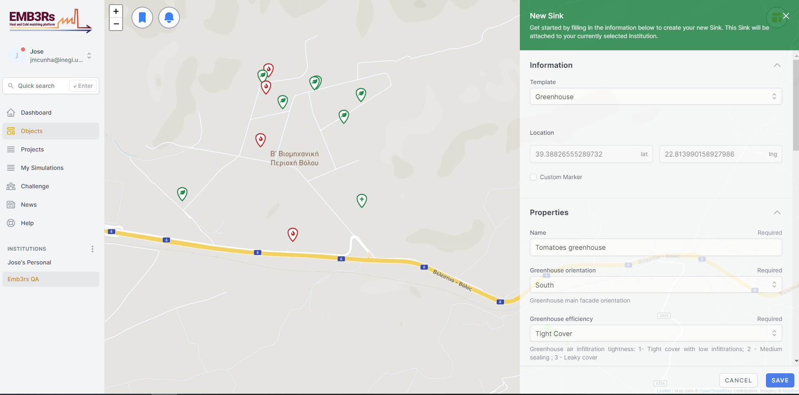
Case implementation –Sink creation (Greenhouse)

Slide 19
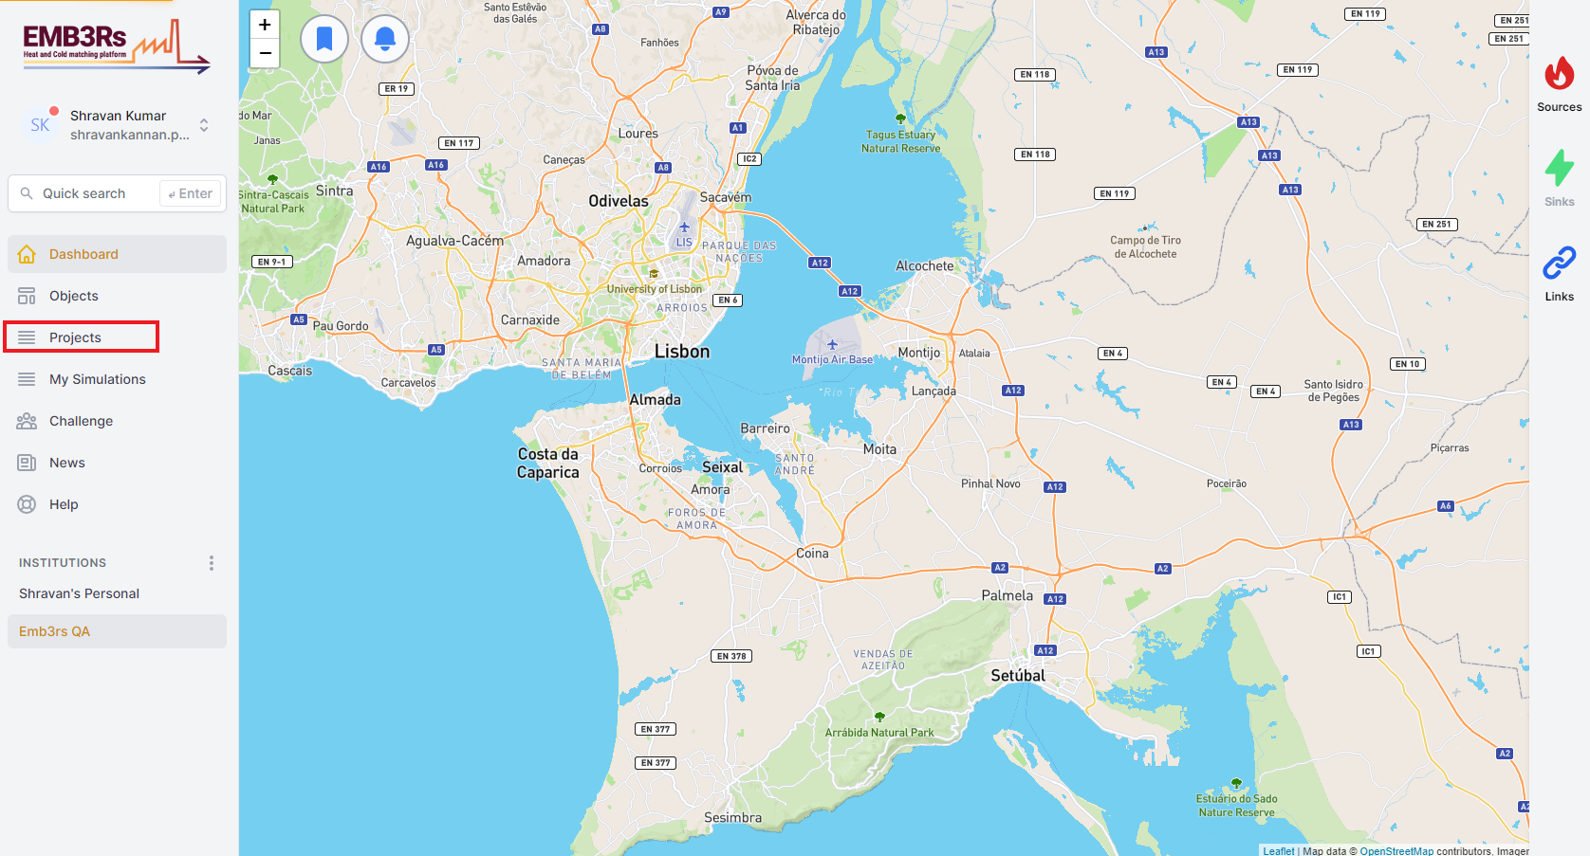
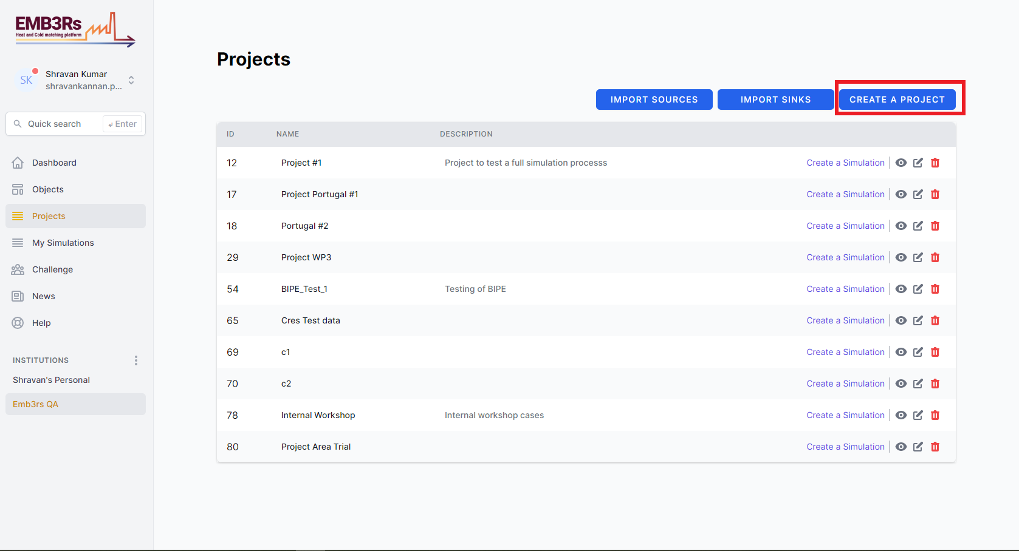
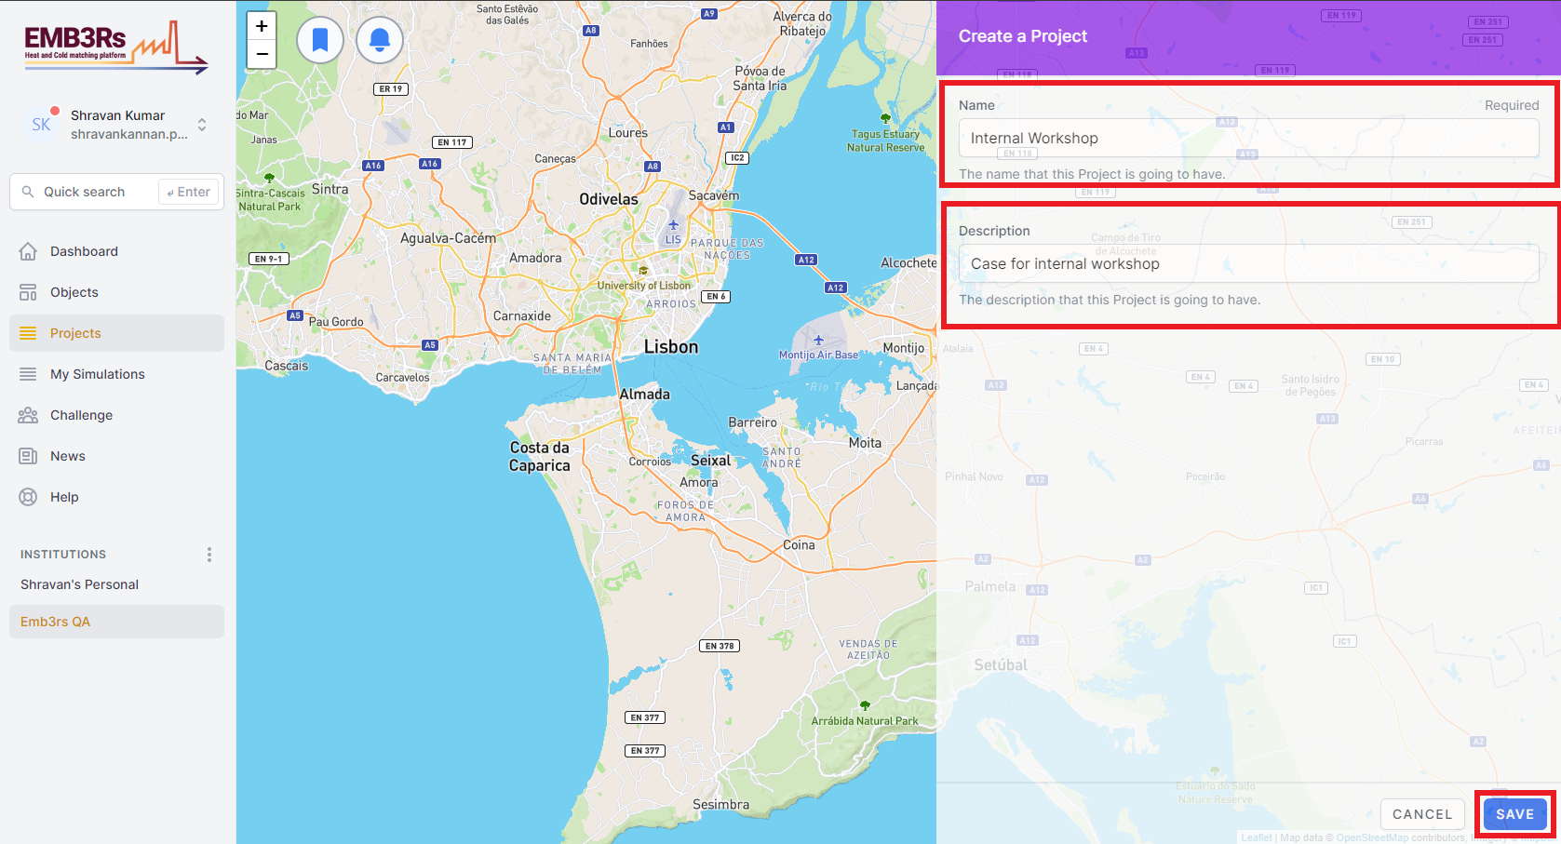
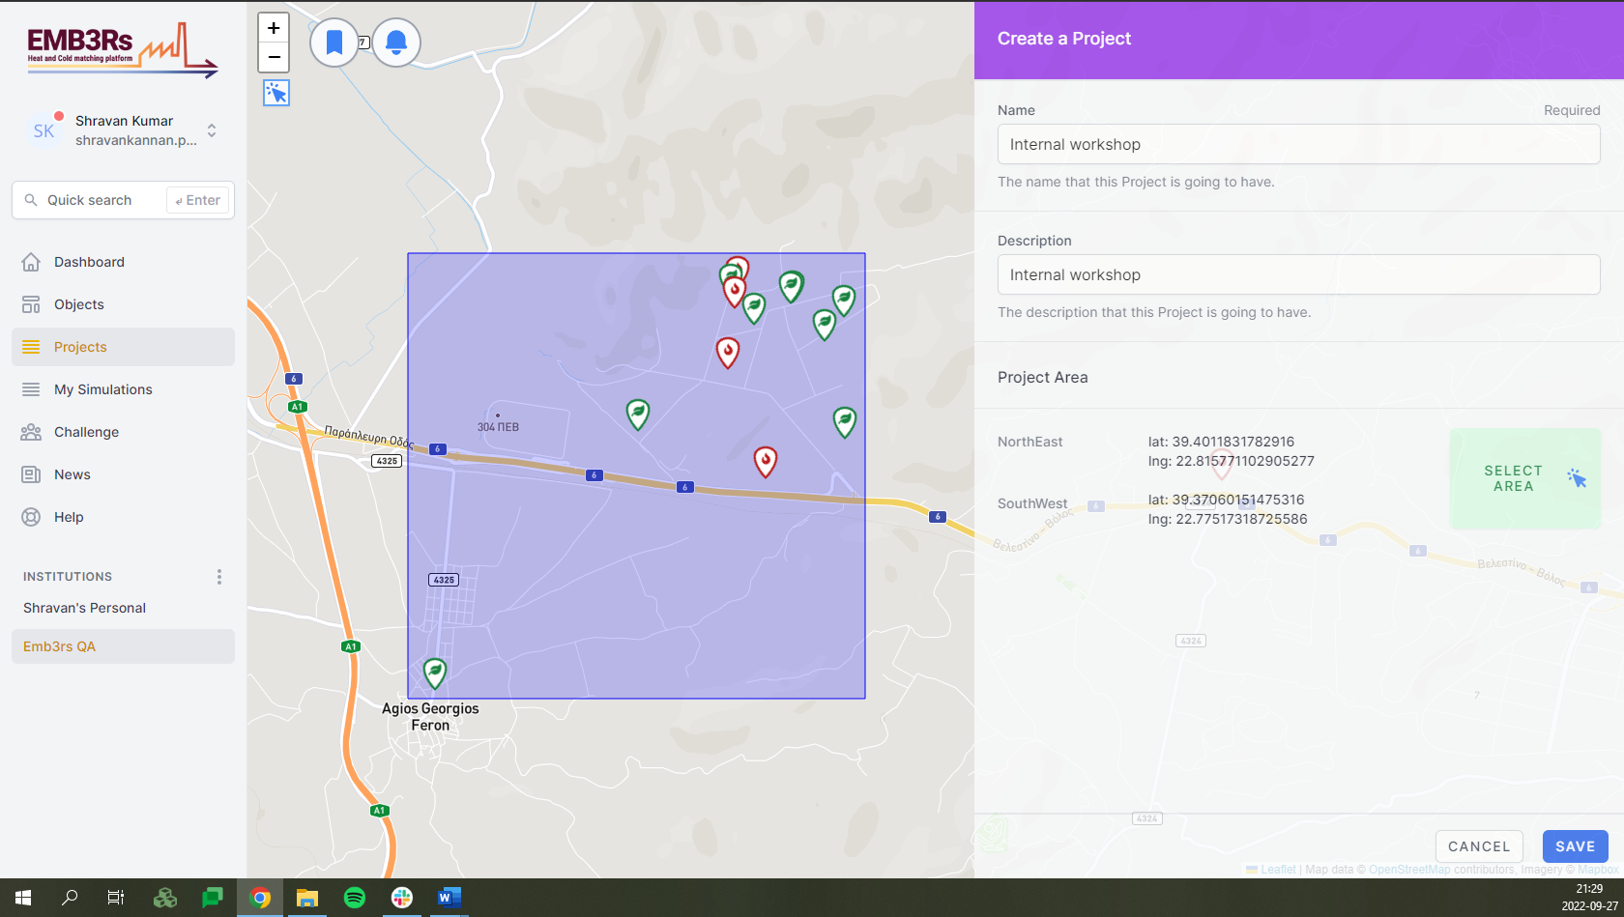
Case implementation – Project creation

Slide 20
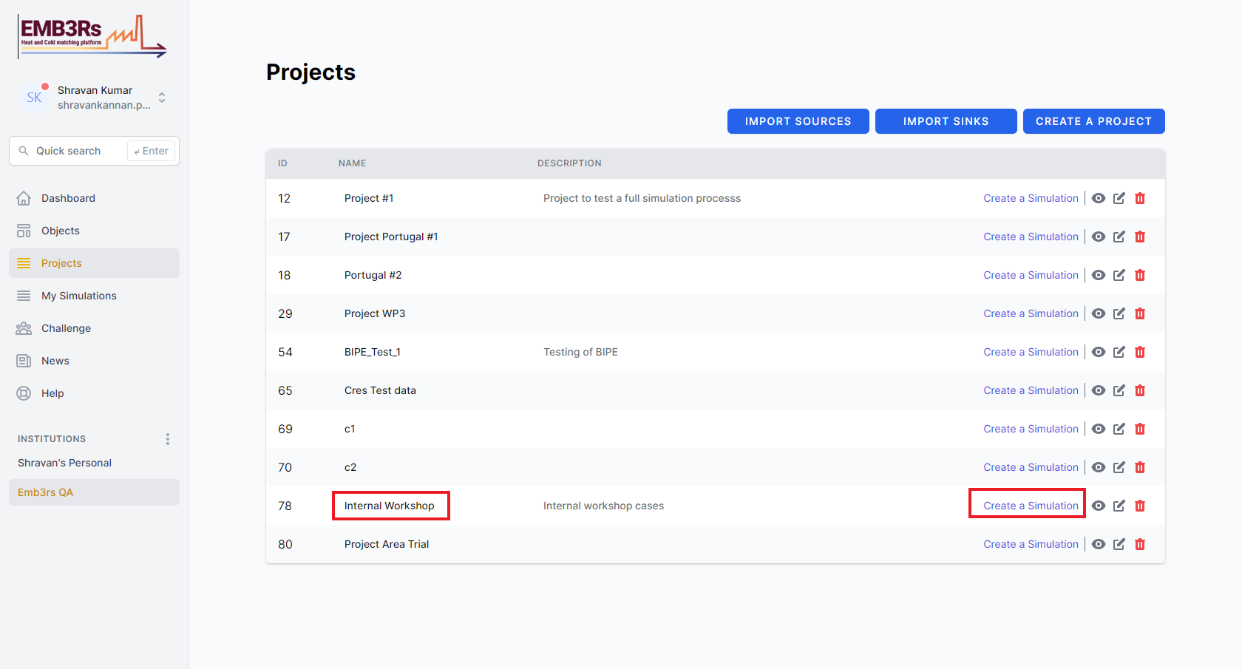
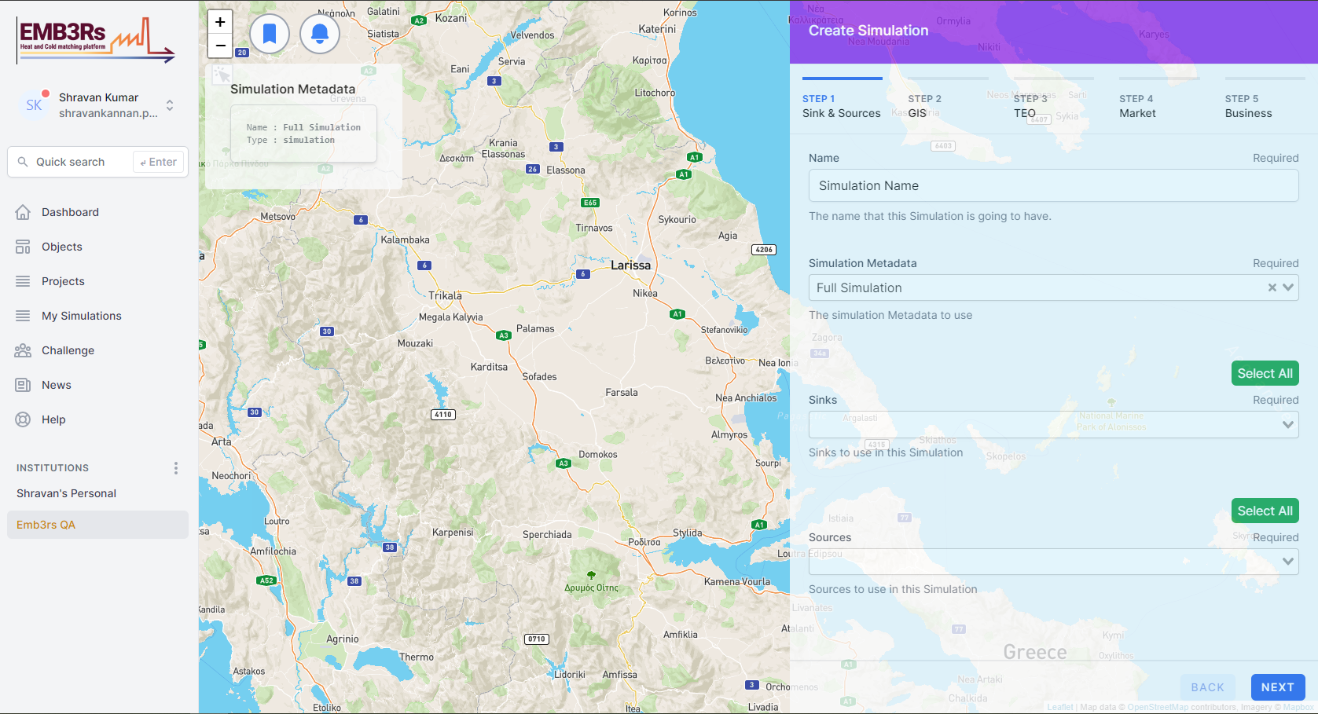
Case implementation – simulation creation

Slide 21
Case implementation – CF inputs
Property | Unit | Sinks
Name | - | Beverage | Packaging | MilkCheese | Fisheye |  | RefriCompany | Town (Hot Water)
Latitude | º | 39.3960678 | 39.398090 | 39.3949277 | 39.397556038 |  | 39.39662745 | 39.371016214
Longitude | º | 22.8058791 | 22.803829 | 22.8121608 | 22.809172868 |  | 22.81391501 | 22.77753353
Fluid | - | water | water | water | water | steam | water | water
Supply Temperature | ºC | 10 | 10 | 10 | 15 | 80 | 15 | 15
Target Temperature | ºC | 80 | 50 | 95 | 80 | 180 | 8 | 60
Capacity | kW | - | - | - | 280 | 1400 | 400 | 700
Mass Flowrate | kg/h | 490 | 2000 | 700 | - | - | - | -
Fluid cp | kJ/kgK | 4,2 | 4,2 | 4,2 | - | - | - | -
Daily Periods | hours | [[6,23]] | [[8,15]] | [[4,23]] | [[0,24]] | [[0,24]] | [[8,18]] | [[6,7],[12,13],[20,22]]
Saturday On | - | NO | NO | YES | YES | YES | NO | YES
Sunday On | - | NO | NO | NO | YES | YES | NO | YES
Shutdown Periods | days | [[244,300]] | [[210,240]] | [] | [] | [] | [] | []
Ref. System - Fuel Type | - | biomass | natural gas | natural gas | natural gas | natural gas | electricity | natural gas
Ref. System Efficiency | - | 0.9 | 0.9 | 0.9 | 0.9 | 0.9 | 3.3 | 0.9
Property | Unit | Sources
Name |  | Polymers | BioInd | Iron&Steel | Stonemill
Template | - | Simple source | Simple source | Simple source | Simple source
Latitude | º | 39.393056 | 39.398611 | 39.385556 | 39.397222
Longitude | º | 22.803611 | 22.804444 | 20.806944 | 22.804167
Fluid | - | water | flue gas | flue gas | flue gas
Supply Temperature | ºC | 80 | 140 | 900 | 250
Target Temperature | ºC | 60 | 120 | 500 | 150
Capacity | kW | - | 80 | 2800 | 1050
Fluid cp | kJ/kgK | 4.2 | - | - | -
Mass Flowrate | kg/h | 12000 | - | - | -
Daily Periods | hours | [[0,24]] | [[6,21]] | [[0,6],[22,24]] | [[6,24]]
Saturday On | - | YES | NO | YES | YES
Sunday On | - | YES | NO | YES | YES
Shutdown Periods | days | [] | [[182,240]] | [] | [[1,10],[140,160]]

Slide 22
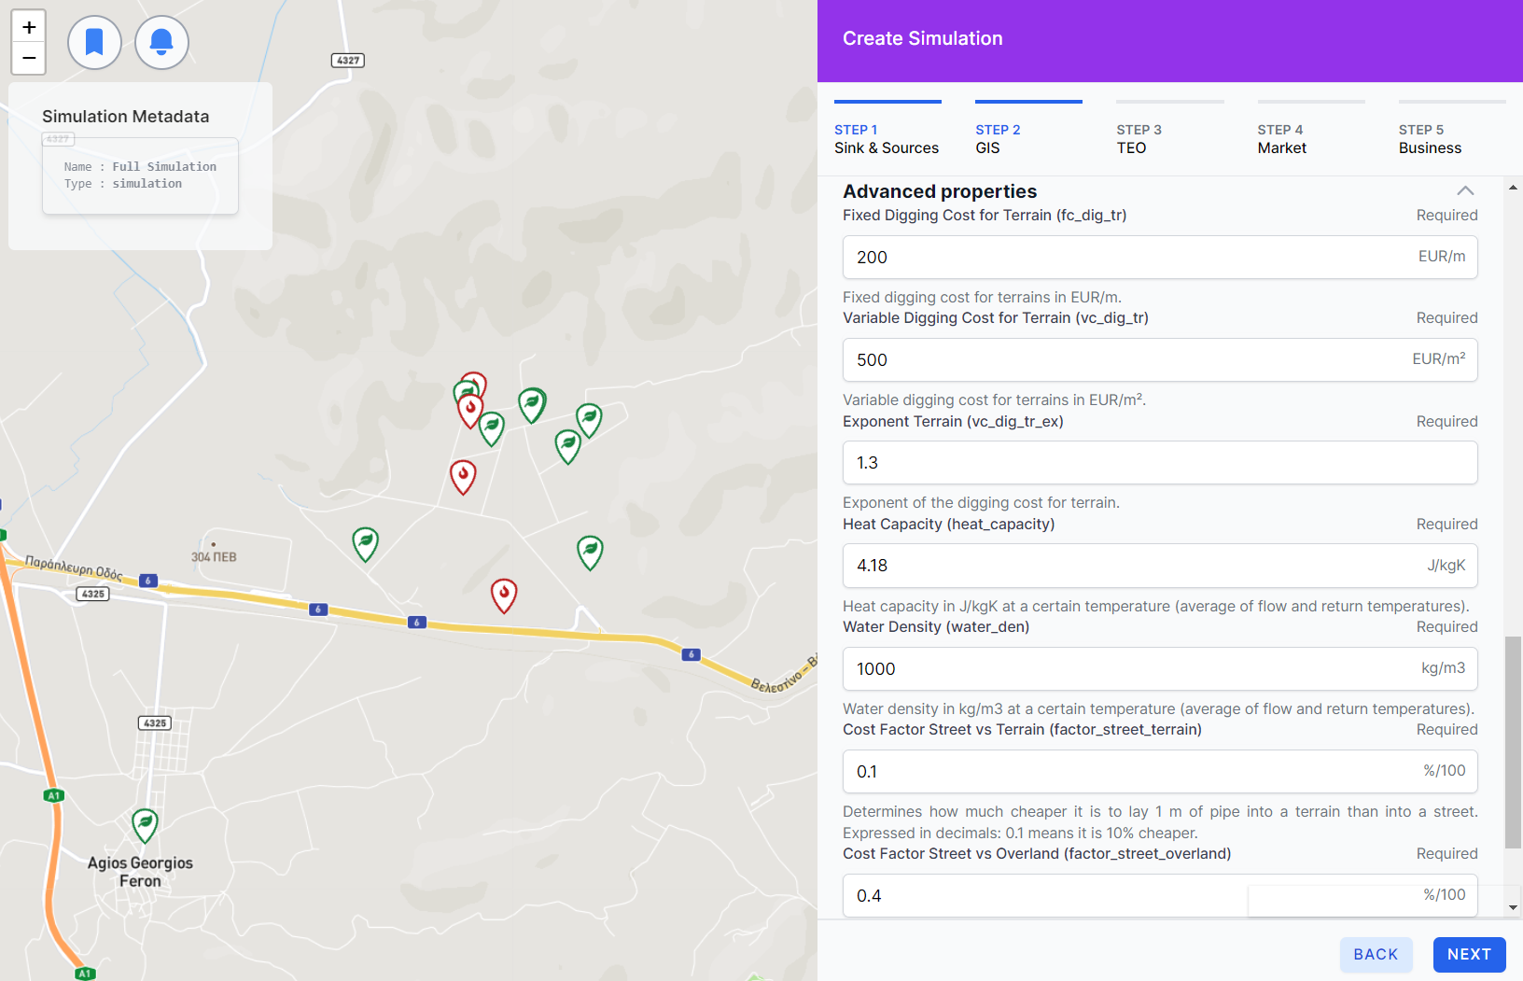
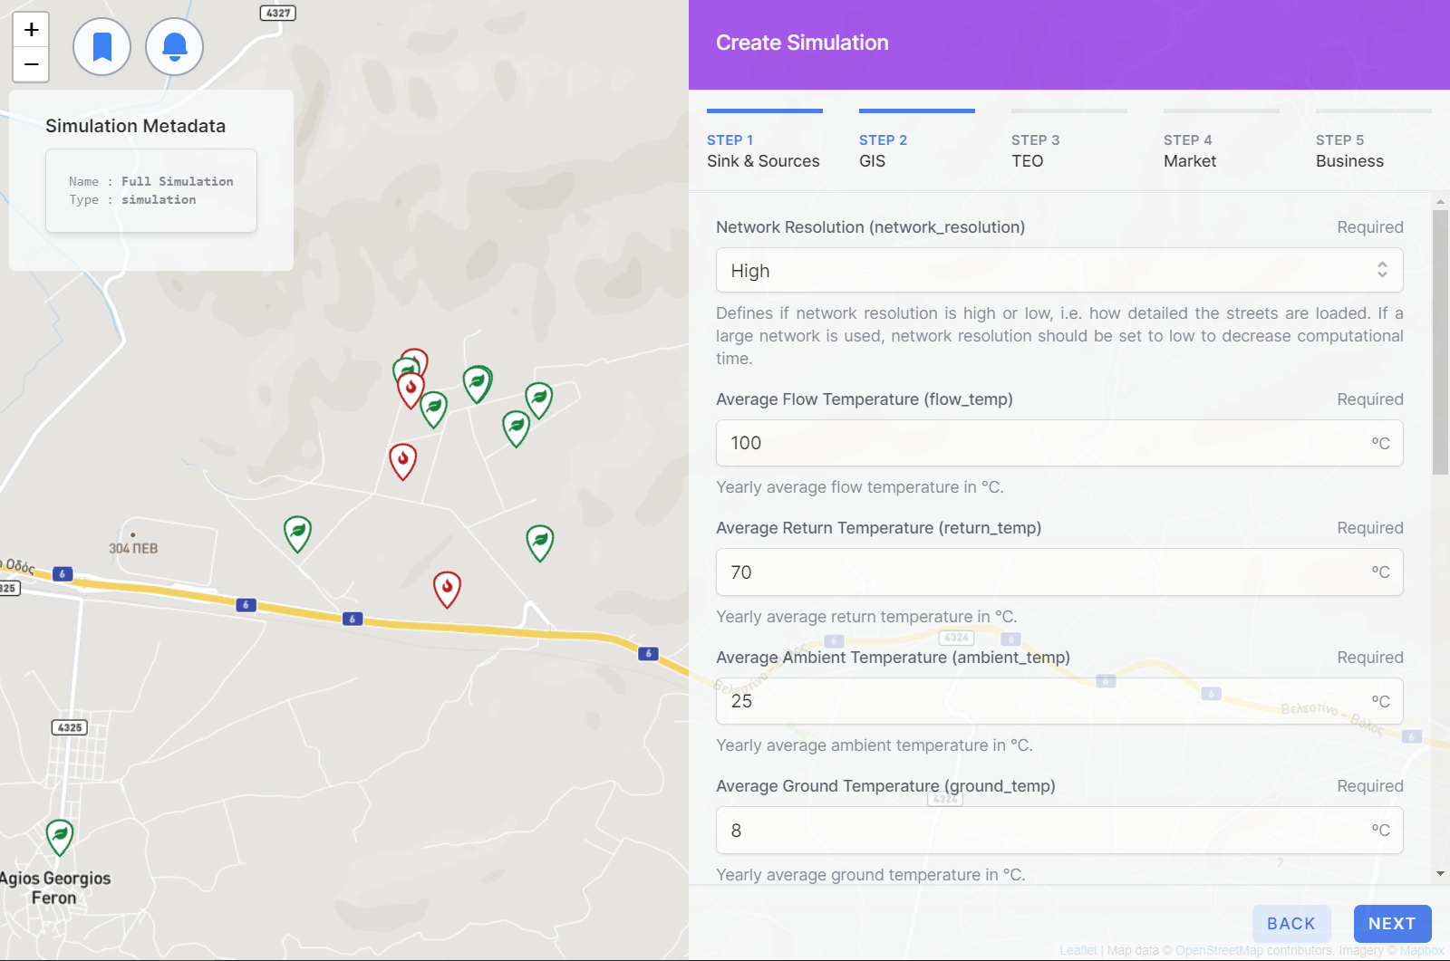
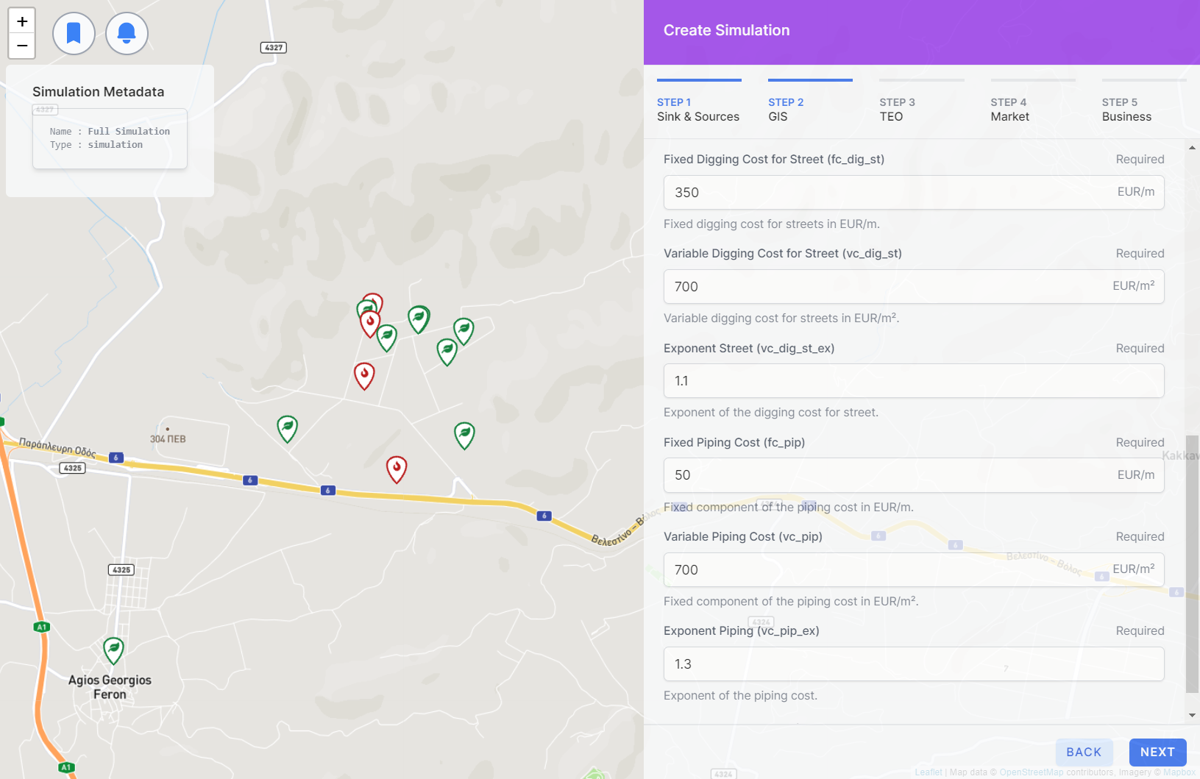
Case implementation – GIS inputs

Slide 23
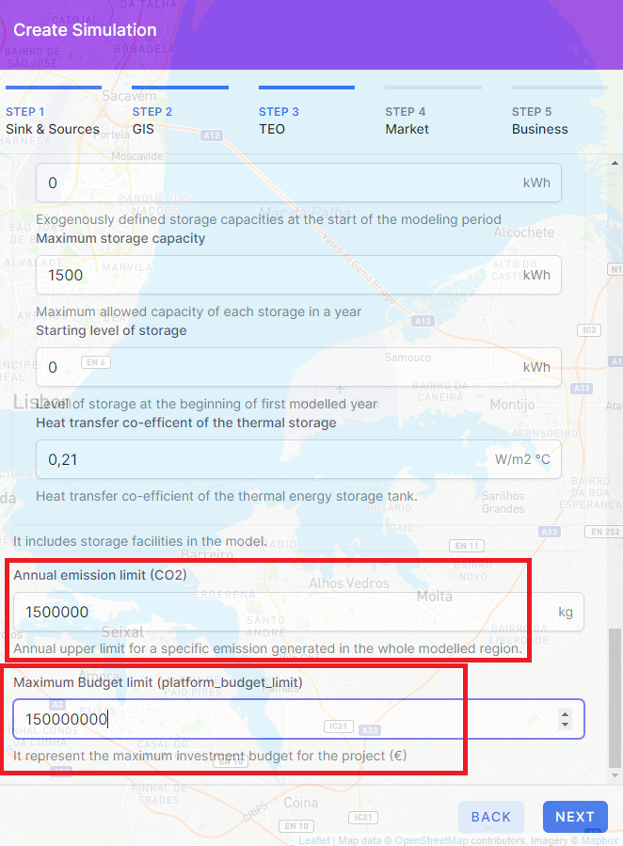
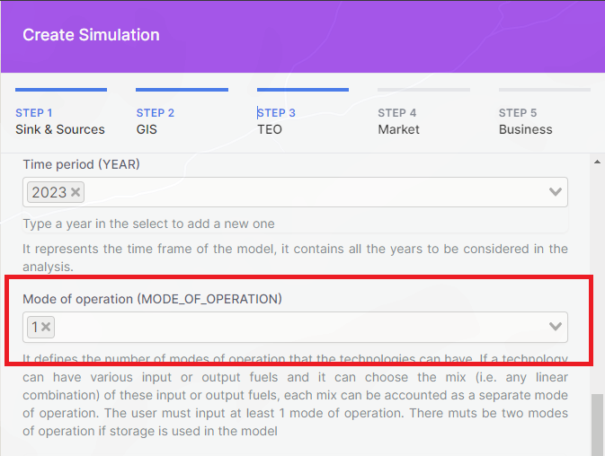
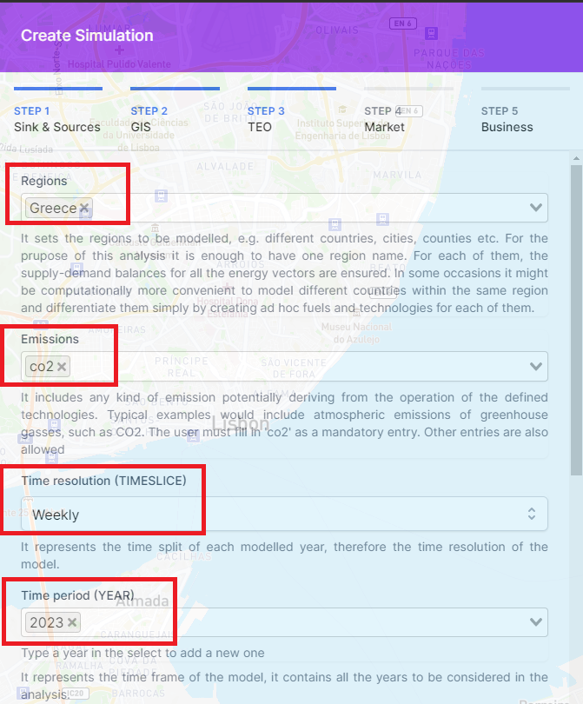
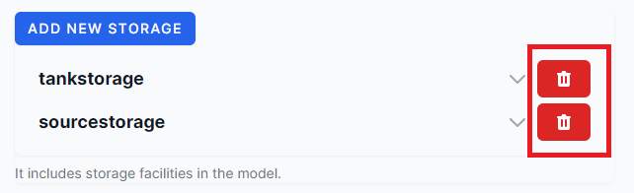
Case implementation – TEO inputs

Slide 24
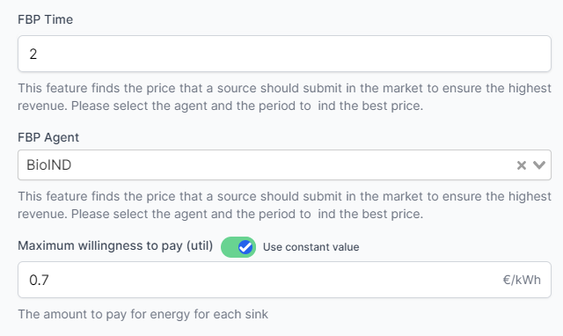
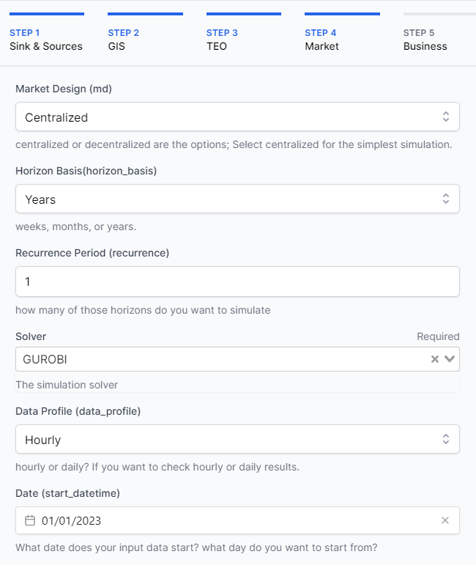
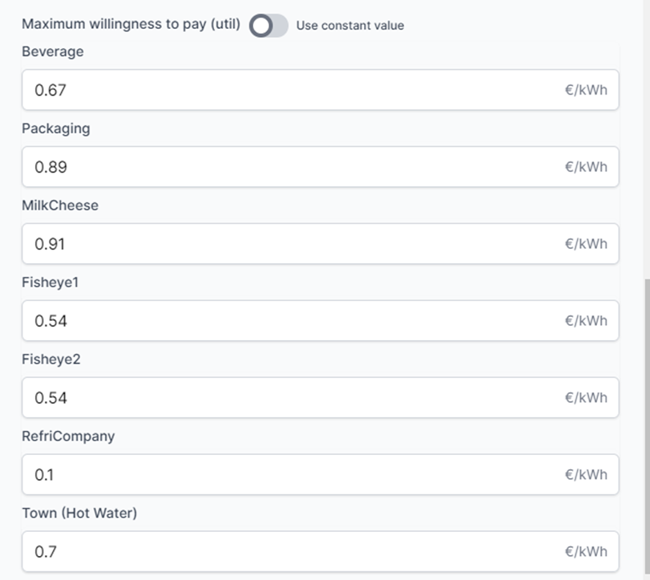
Case implementation – MM inputs

Slide 25
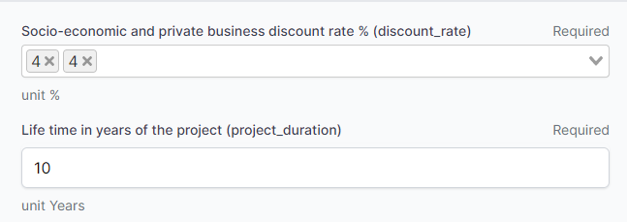
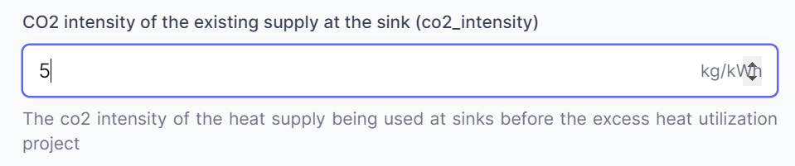
Case implementation – BM inputs
Discount rates (Mandatory):
1st one socio-economic – easy to find
2nd one Private business – Compromises can be made
Life-time of the project in years (Mandatory)
CO2 intensity of existing supply at the sink – optional – not even implemented yet

Slide 26

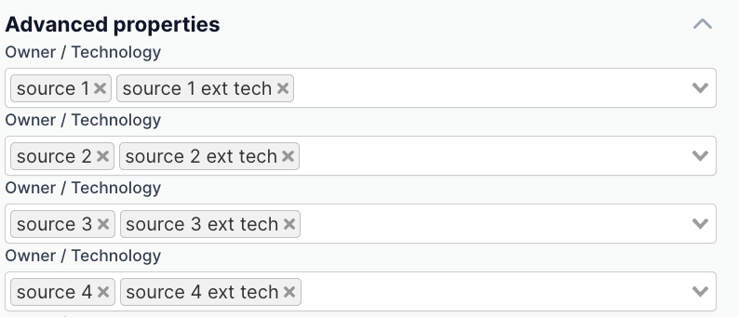
Case implementation – BM inputs
Grid ownership structure (Mandatory)–
who share the grid cost?
Unit: % share /100; sum should be equal to zero
Technology ownership structure (Mandatory)-
Who owns the technologies (heat exchangers, storages, backup boilers etc) installed at different sources and sinks?
Always have a default value - (don't change it if you are not sure about it)
Grid ownership and Technology ownership input will be made more user friendly by the PDM.

Slide 27
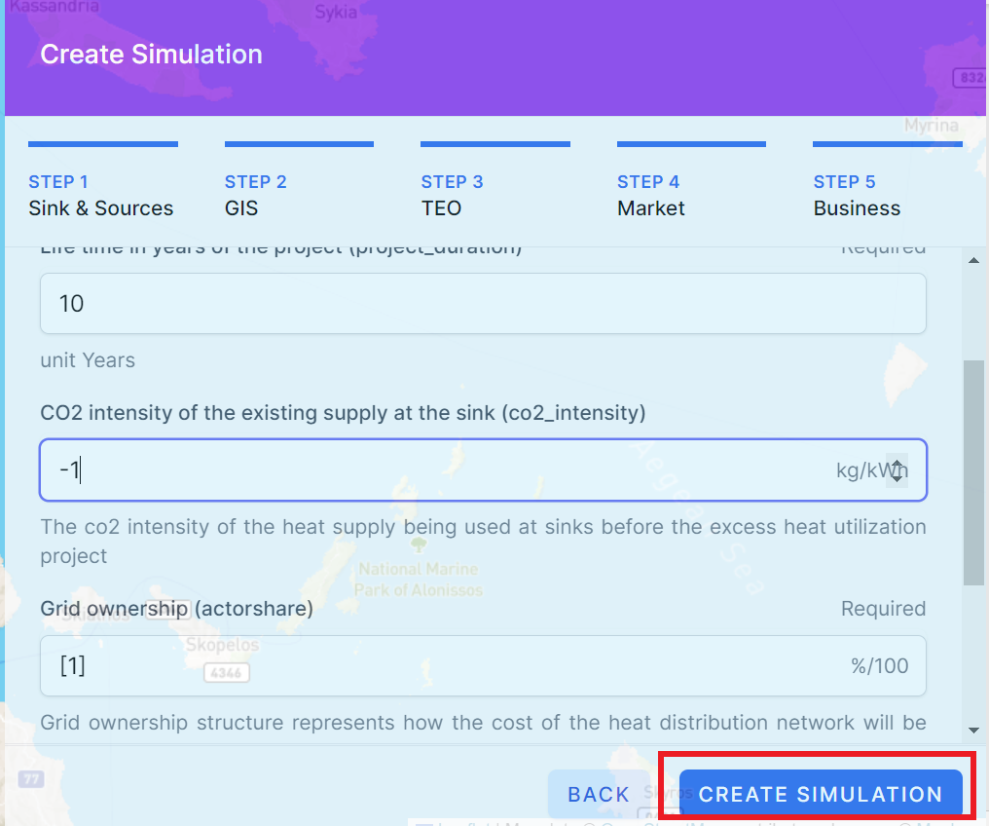
Case implementation – Run and reports

Slide 28
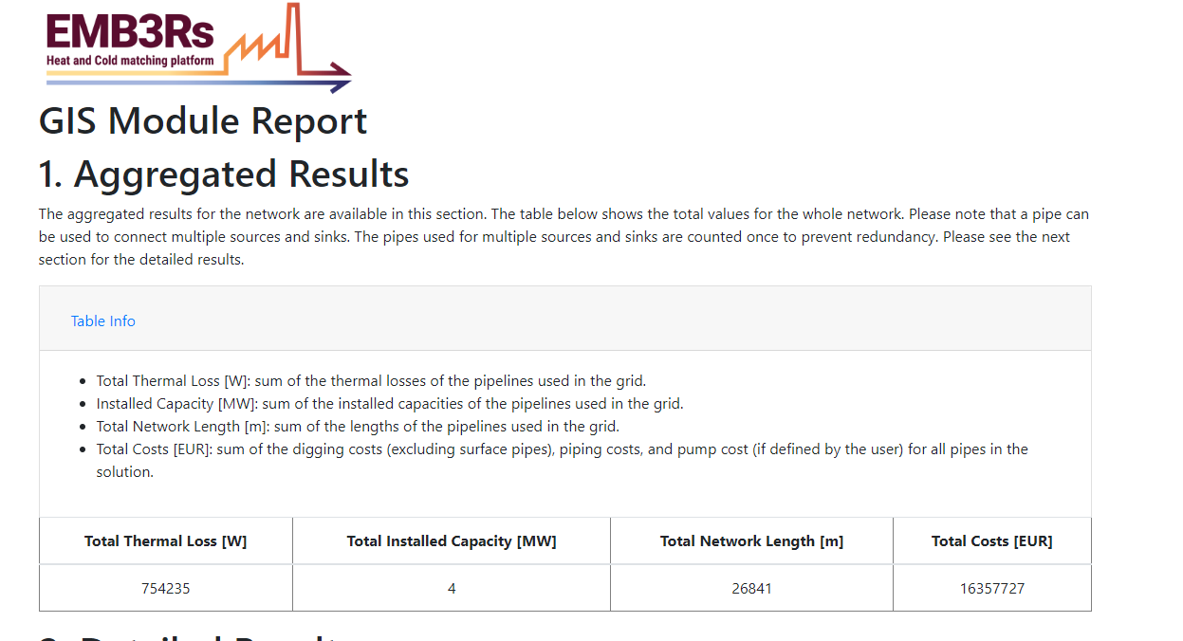
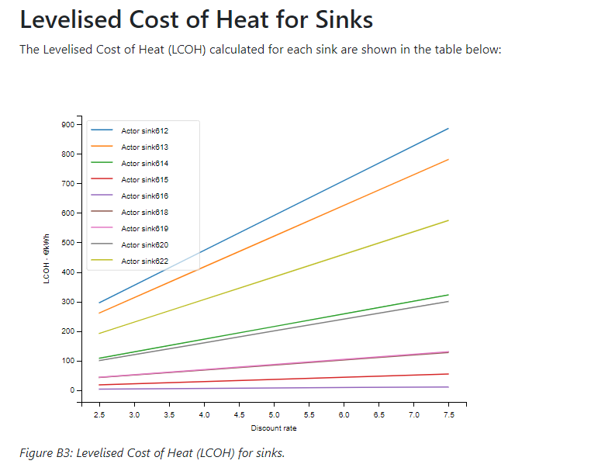
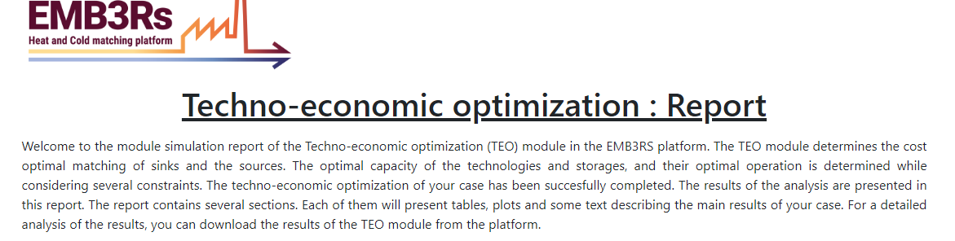
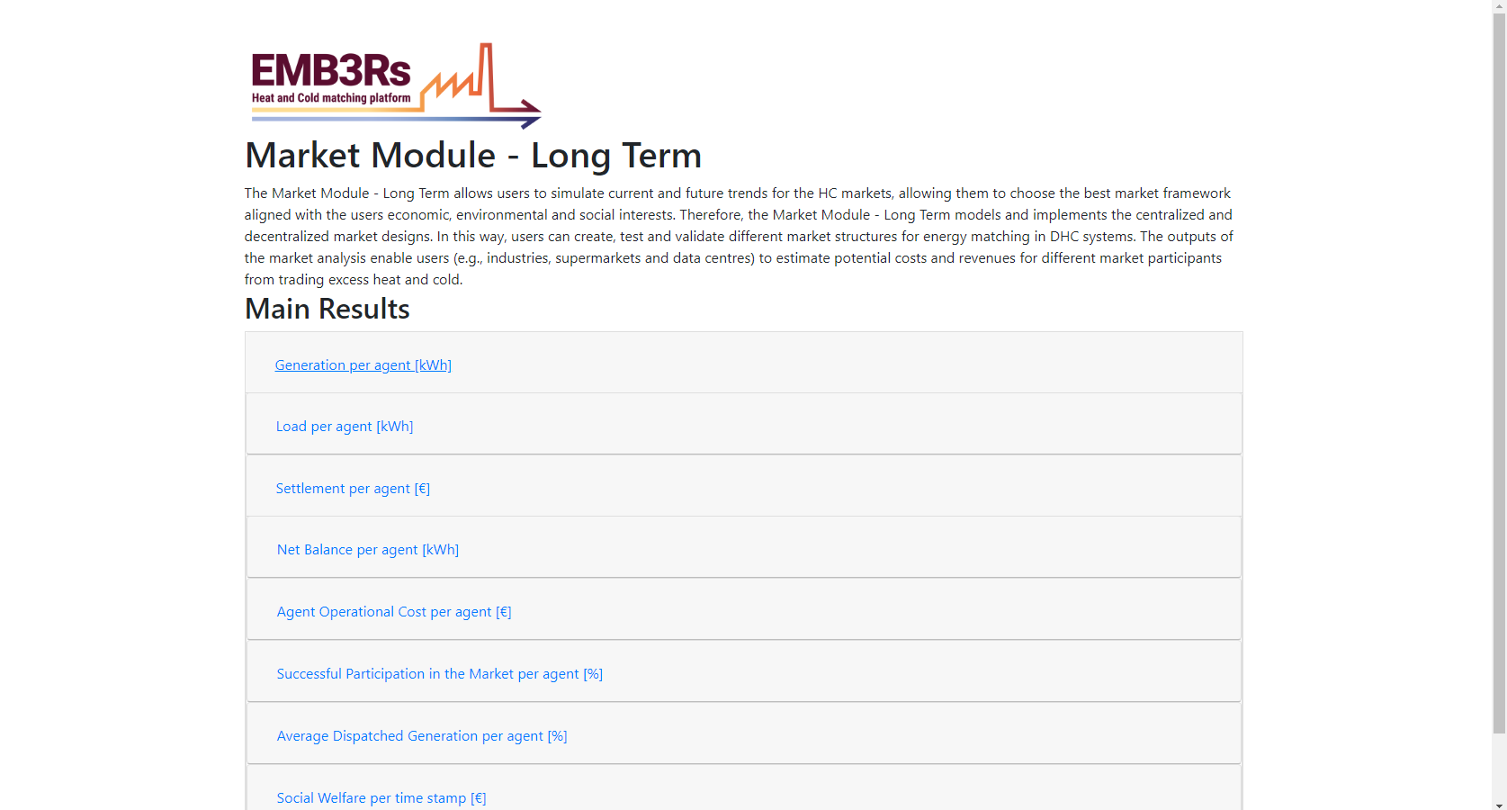
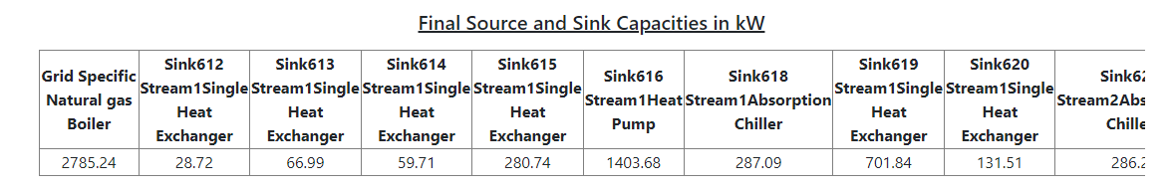
Case implementation – Run and reports
The results reporting is still work in progress, but we'll navigate you through key outputs and welcome your feedback...

Slide 29
Now time to try...
Time is tight... Please think of:
1) How this can be useful for your work
2) What features work best and what need improvement
3) How easy it would be to replace sample data with real data
4) If you are a modeller, how does the code base & module linking look like? Any doubts, curiosity?
This time is for feedback – we want to make this platform a service to the community of modellers & practitioners

Slide 30


Thank you!
Good luck for the hands-on experience
Follow us on :
emb3rs_project
https://www.emb3rs.eu/

